Slide 1
Neonatal Pneumonia

Slide 2
20 to 30% of all deaths from acute respiratory infections in children under 5 years occur during the first two months of life.
96% of all neonatal deaths occur in developing countries.

Slide 3
CLASSIFICATION
EARLY-ONSET PNEUMONIA : before 3 days of life.
Or <7 days
LATE-ONSET PNEUMONIA : after 3 days of life.
Or >7days
Gram negative bacteria predominate in the first week and Gram positive bacteria predominate subsequently (developing countries).

Slide 4
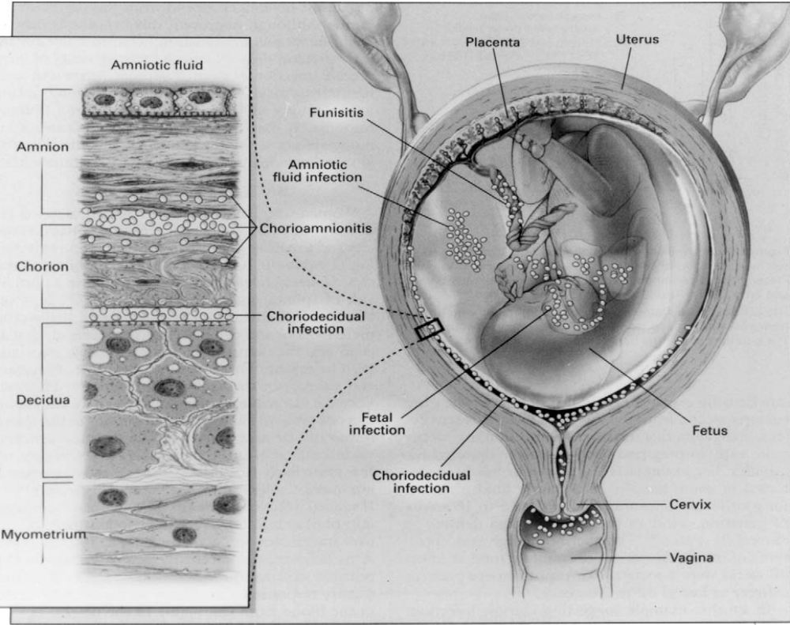

Slide 5
EARLY-ONSET PNEUMONIA
Transplacental: Listeria monocytogenes, Mycobacterium tuberculosis, Treponema pallidum, rubella virus, cytomegalovirus (CMV), herpes simplex virus (HSV), adenovirus, and influenza A virus.
Prolonged rupture of the membranes:
+ Group B Streptococcus(GBS) - 70%
+ Escherichia coli – 40%
+ Haemophilus influenzae, Streptococcus pneumoniae,Listeria monocytogenes, Klebsiella pneumoniae, Candida albicans.

Slide 6
Risk factors for early pneumonia
Maternal colonization with GBS
Signs and symptoms of chorioamnionitis
Prolonged(>18 hours) rupture of membranes

Slide 7
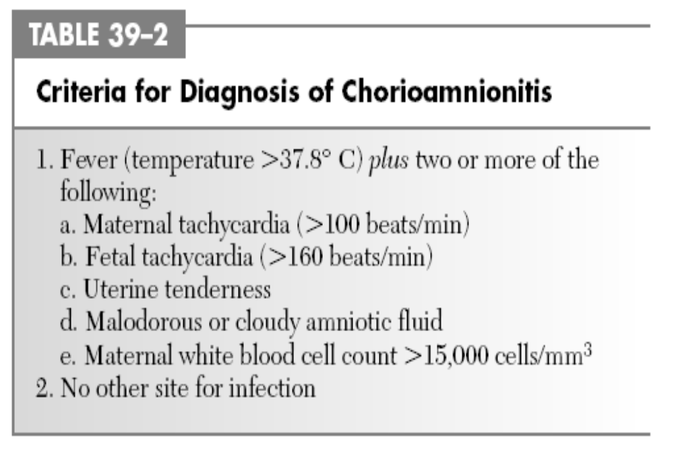

Slide 8
Clinical manifestations of early-onset pneumonia
symptoms within the first 48 hours after birth.
respiratory distress: tachypnea, retractions, grunting,cyanosis..
nonspecific signs: poor feeding, febrile or hypothermic, lethargy, apnea, tachycardia, abdominal distention…
Cough is an unusual symptom in neonatal pneumonia.

Slide 9
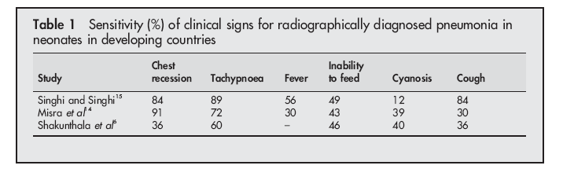

Slide 10
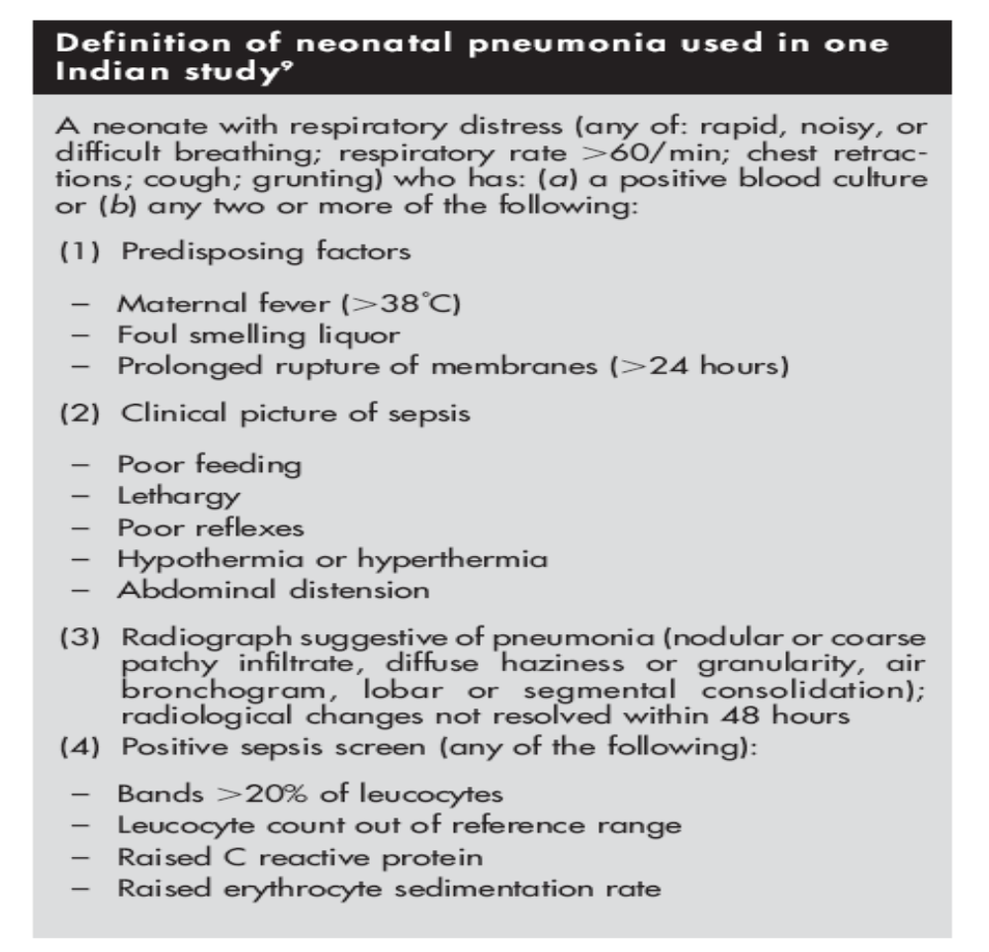

Slide 11
Differential diagnosis for early neonatal pneumonia
Transient tachypnea of the newborn (TTN),
RDS (RESPIRATORY DISTRESS SYNDROME)
MAS(Meconium Aspiration Syndrome)
Pulmonary congestion secondary to obstructed anomalous pulmonary venous return
Left heart obstructed lesions

Slide 12
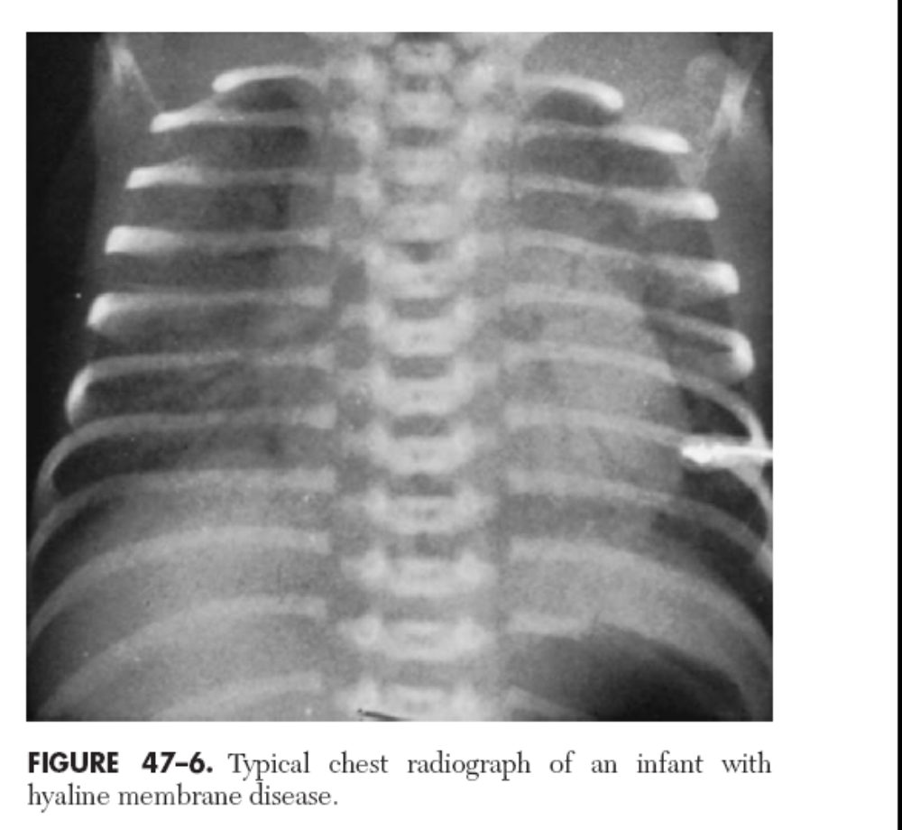

Slide 13
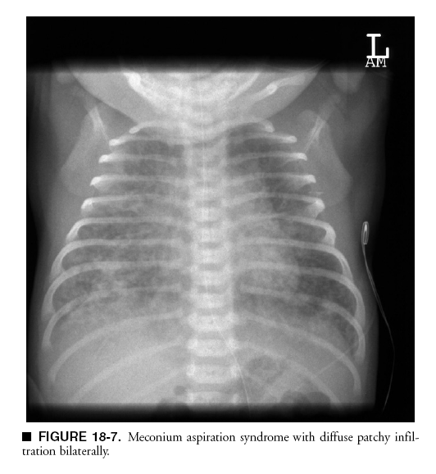

Slide 14
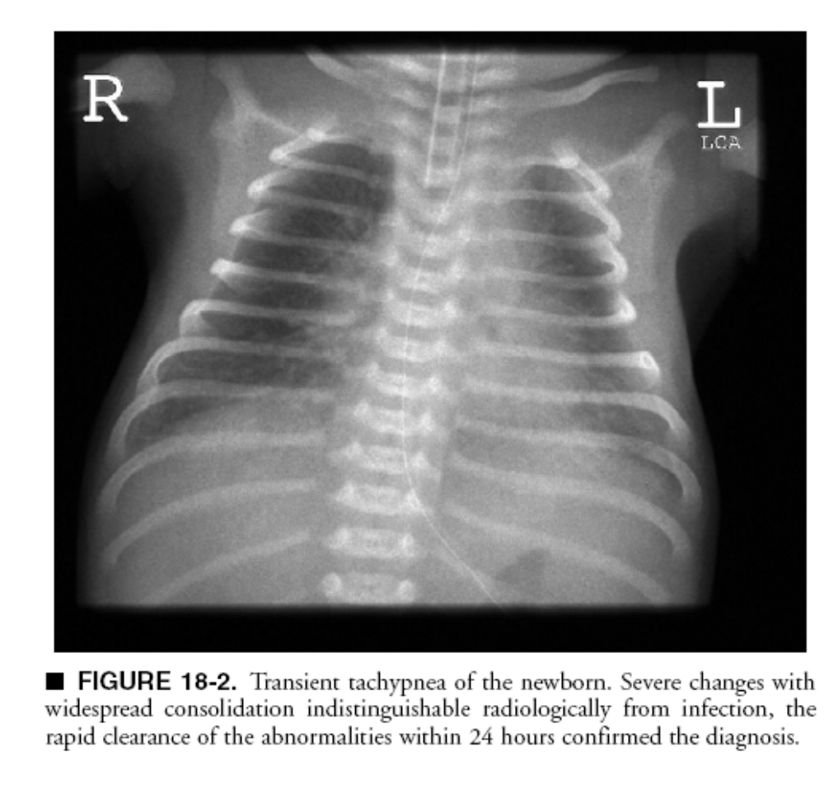

Slide 15
TREATMENT- early neonatal pneumonia
Oxygen and supportive care:SpO2 85%-92%.
All infants with respiratory distress should receive antibiotic treatment.
First line:
Ampicillin + Gentamycine
(Group B Streptococcus,Listeria monocytogenes)
Cefotaxim + Gentamycine ( E.coli “ampicillin-resistant E.coli” , Hemophilus influenzae and Klebsiella, predominate in some Asian)
Cloxacillin(skin pustules,cellulitis, umbilical cord infection)
Cefotaxim + Ampicillin + Gentamycine

Slide 16
TREATMENT- early neonatal pneumonia
Second line : according to culture results
10 to 14 days of therapy
3 weeks if the pneumonia is due to Staphylococcus aureus.

Slide 17
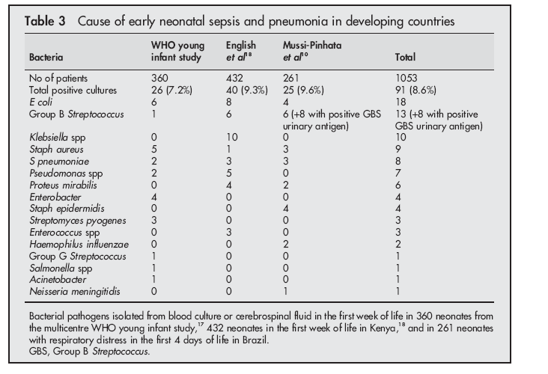

Slide 18
LATE-ONSET PNEUMONIA
Caused by organisms that colonize the newborn during the hospital stay.
The most cause: coagulase-negative staphylococci, S. aureus, and gram-negative bacilli, including Klebsiella, E. coli, and Pseudomonas.
The most cause in developing countries: S.pneumoniae, Gram negative bacilli.

Slide 19
Viruses can also cause lateonset pneumonia: RSV, influenza virus…
Fungal infections: if infants have had prolonged exposure to antibiotics, particularly third-generation cephalosporins;
HIV and neonatal pneumonia: persistent pneumonia.

Slide 20
Atypical pathogens
Congenital syphilis:
+Congenital syphilis is still a major cause of neonatal infection in many developing countries
+The cause of death in 13.5% (17 of 126) neonates
Chlamydia trachomatis:
+ Perhaps make mucosal injury, to secondary bacterial infection.
+ Positive C trachomatis nasopharyngeal Aspirates
+ No isolation of C trachomatis from a percutaneous lung aspirate.

Slide 21
Treatment: late-onset pneumonia
Community acquired neonatal pneumonia
Ampicillin + Gentamycine
Acquired in hospital
Vancomycin + Gentamycine
Cefotaxim + Gentamycine
Cefotaxim + Vancomycine

Slide 22
PREVENTION
Intrapartum antibiotic therapy for women colonized with GBS. (Ampicillin, 2 g IV as a loading dose followed by 1 g q4h until delivery.)
Early and exclusive breast feeding
Prevention of nosocomial pneumonia
(The single most important intervention for infection control for protecting newborns from nosocomial sepsis is hand washing)
Prevention and treatment of sexually transmitted infections: syphilis, Chlamydia, and HIV

Slide 23
PREVENTION
Vitamin A supplementation at birth
+ Giving 24 000 IU vitamin A on day 1 and day 2 of life
or 50 000 IU vitamin A on the first day
+ Two large randomised trials have shown that vitamin A supplementation at birth reduces young infant mortality
+ The incidence of cough and fever were significantly lower in the first 4 months

Slide 24
Nguyên nhân tử vong Viêm phổi sơ sinh tại BV Nhi đồng 2-2007- tỷ lệ tử vong :7,3%(24/331), VP sớm 75%(18),VP trễ 25%(6)
Nguyên nhân tử vong | Số ca(n=24) | Tỷ lệ %
VP bệnh viện+ NTH | 10 | 41,7%
VP cộng đồng + TBS | 6 | 25%
VP hít phân su | 3 | 12,5%
VP bệnh viện + NTH+ TBS | 2 | 8,3%
VP cộng đồng | 2 | 8,3%
VP hít phân su + TBS | 1 | 4,2%

Slide 25
TÀI LIỆU THAM KHẢO
1)Duke T (2005), “Neonatal pneumonia in developing countries”, Arch Dis Child, 90, pp.211-219.
2) “Respiratory Disorders in the Newborn”, Kendig,s disorders of the respiratory tract in children 7th ed, Saunders, Philadelphia, pp. 317-356.
3) “Respiratory Disorders in Preterm and Term Infants” Fanaroff 9th,pp1160-62

